Slide 1
South Carolina Chamber of Commerce
Discussion on South Carolina Business Personal Property

Slide 2
Business Personal Property Tax

Slide 3
What is Business Personal Property(BPP)?
Depreciable property owned and actively used in operating a business in South Carolina.
Examples: equipment, fixtures, and furniture
Excluded from BPP taxation are non-depreciable and real property items
Examples: inventory and intangible assets
Personal property is generally reported separately from land and buildings

Slide 4
Business Personal Property Taxation in SC
Assets are taxed annually based on depreciated value
Net Depreciated Value is calculated using federal depreciation tables and SC-specific rules
Minimum 10% of original cost must remain (no full depreciation in SC)
Companies must keep multiple detailed depreciation records (Federal, State and BPP)
Must keep physical track of all fixed assets for abandonment and disposal
Assessment Value = Net Depreciated Value × 10.5%.
Tax Due = Assessment Value × local millage rate
Millage rate varies by county and district

Slide 5
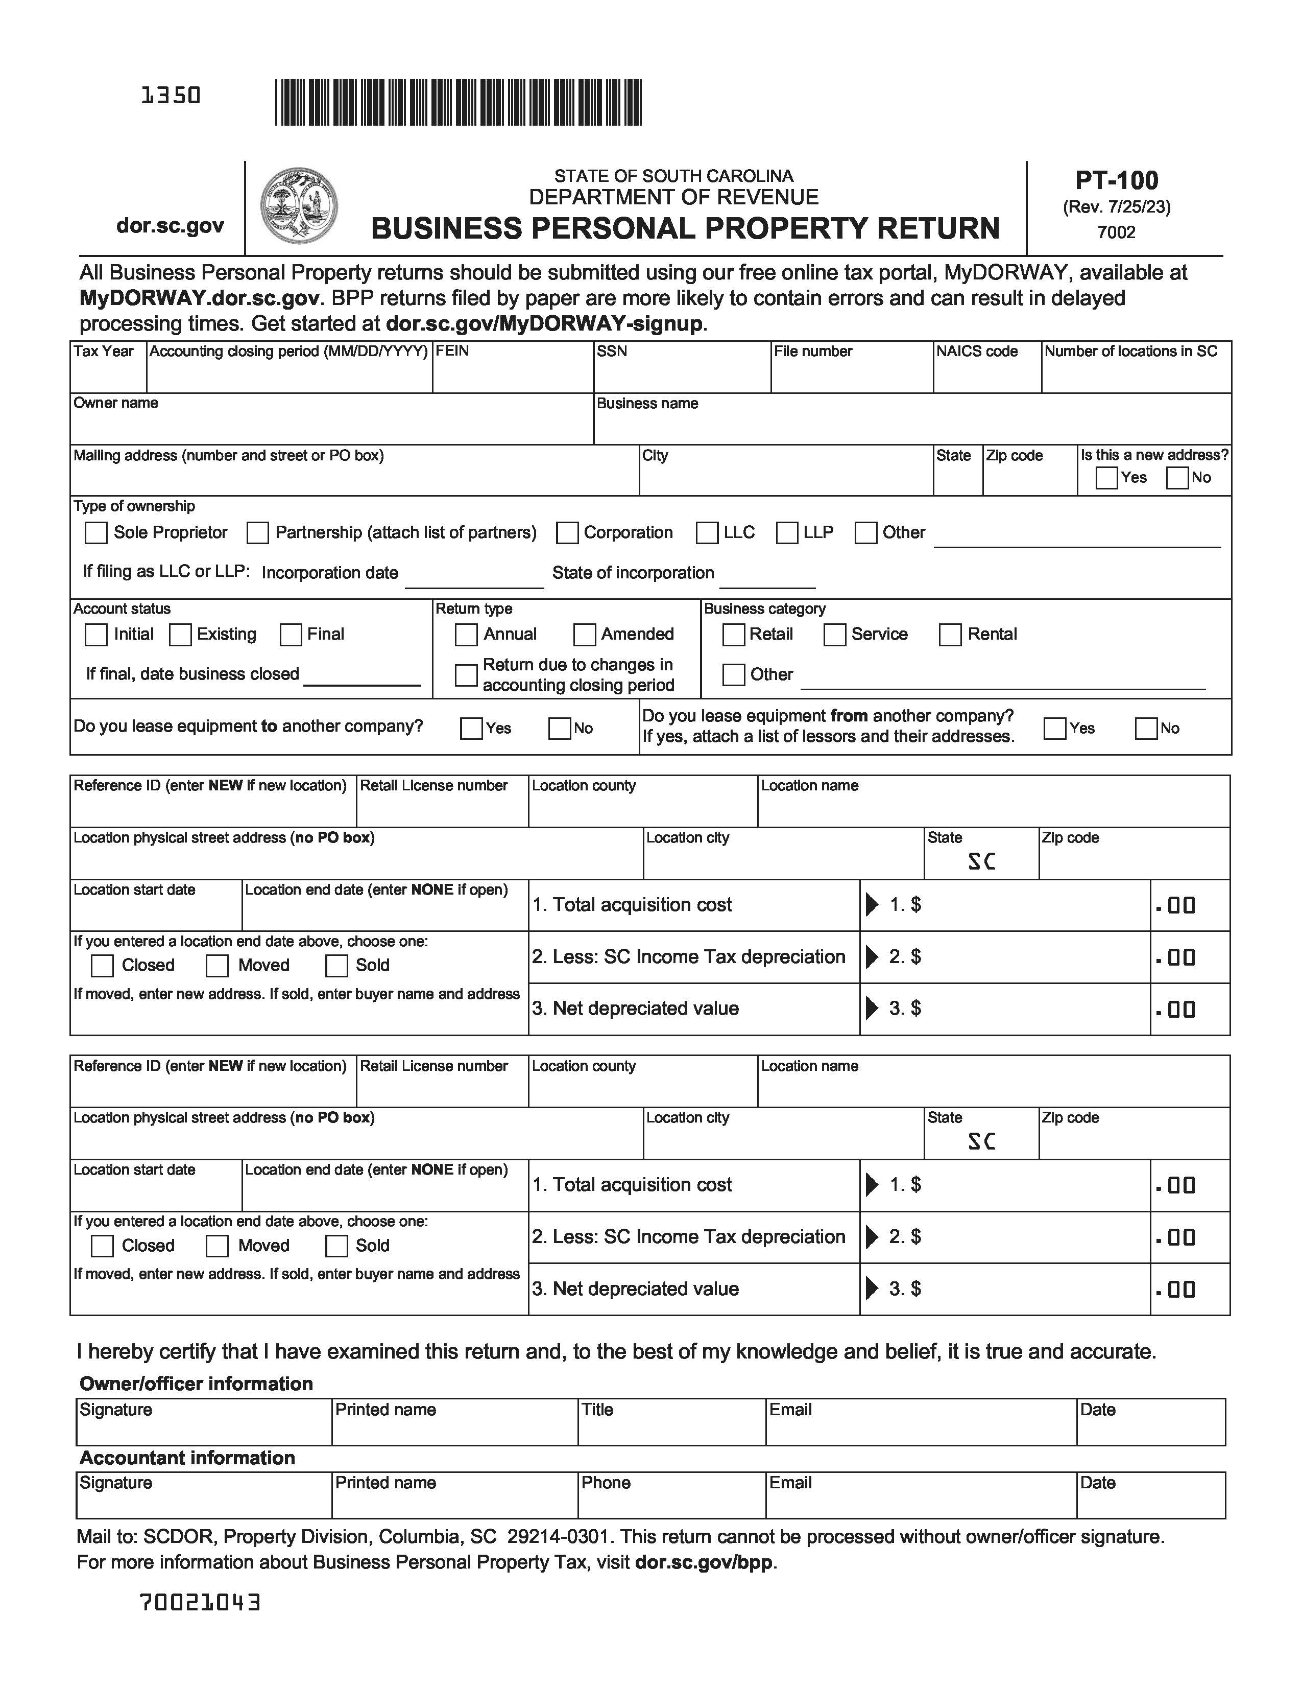
Filing Requirements
Who: All businesses that own personal property operating in SC
What: Applicable “Business Personal Property Return” Form (PT-100 pictured right)
When: Last day of the 4th month after year- end, April 30th if calendar year end 12/31.
Where: File tax return with the SC Department of Revenue or county, depending on industry classification. File property tax return electronically on-line or by paper.

Slide 6
BPP Put Into Perspective

Slide 7
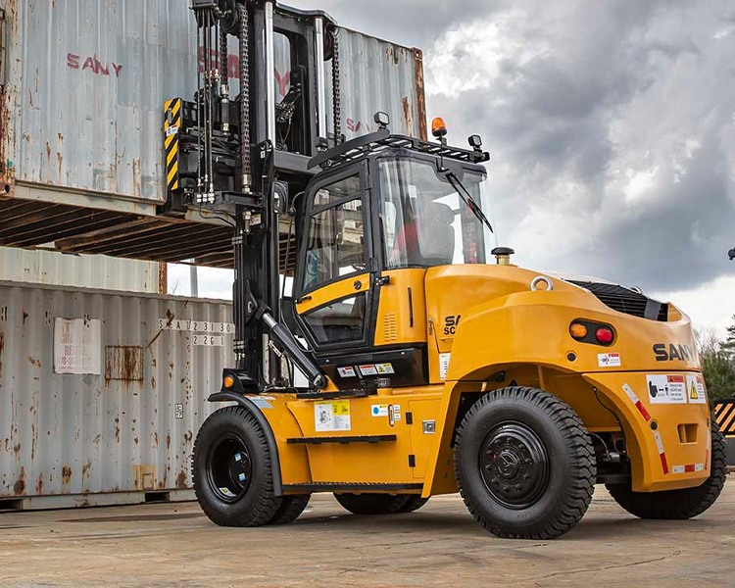
BPP Tax Illustrated
A Forklift or business equipment is placed in service in 2017
Cost is $100,000
MACRS Class: 5 year
Calendar Year Business
Located in Columbia ,Richland District 1
Applicable Millage Rate is 521.5 mills

Slide 8
BPP Tax Illustrated (continued)
Year | MACRS % | Depreciation | Net Book Value (Federal) | SC NBV (Min 10%) | Assessment (10.5%) | Tax Due (521.5 mills)
2017 | 20.00% | $20,000 | $80,000 | $80,000 | $8,400 | $4,379
2018 | 32.00% | $32,000 | $48,000 | $48,000 | $5,040 | $2,627.56
2019 | 19.20% | $19,200 | $28,800 | $28,800 | $3,024 | $1,576.65
2020 | 11.52% | $11,520 | $17,280 | $17,280 | $1,814.40 | $946.63
2021 | 11.52% | $11,520 | $5,760 | $10,000 (min) | $1,050 | $547.58
2022 | 5.76% | $5,760 | $0 | $10,000 (min) | $1,050 | $547.58
2023- Onward | — | — | $0 | $10,000 (min) | $1,050 | $547.58
 |  |  |  |  | Total Taxes Paid= | $11,172.58

Slide 9
Challenges related to Business Personal Property Tax
Complex Filing
Businesses must file with SCDOR or county auditors, depending on the type of business and their location(s)
Lack of Awareness by Business Owners
Property tax returns should be filed timely
Minimum Value Rule
Assets can’t be depreciated below 10% of original cost extending tax liability causing continual taxation

Slide 10
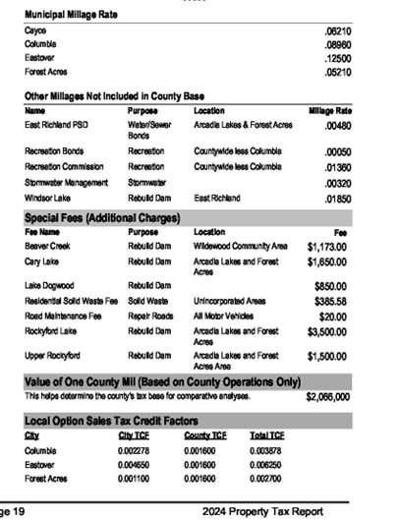
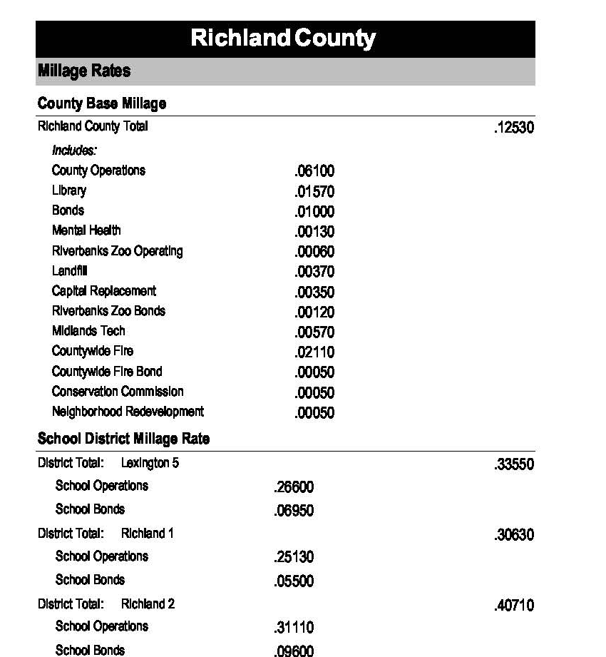
Challenges related to BPP Tax (continued)
Confusing Millage Rates
Millage rates vary county to county
Districts in counties will also have different rates

Slide 11
Challenges related to BPP Tax (continued)
Penalties & Enforcement
10% late penalty
Risk of liens
Asset seizure
Property attachment

